Slide 1
Deep Feed Forward Neural Networks- A complete review
Umarani Jayaraman

Slide 2
Outline
Linear classifier
perceptron
Non-linear classifiers
MLP, Neural Networks
Optimization Techniques
Loss Optimization – Gradient Descent
Batch Optimization – Batch, Stochastic and Mini-Batch
Overfitting – Dropout, Early Stopping

Slide 3
Linear Classifier-The Perceptron
The structural building block of deep learning

Slide 4
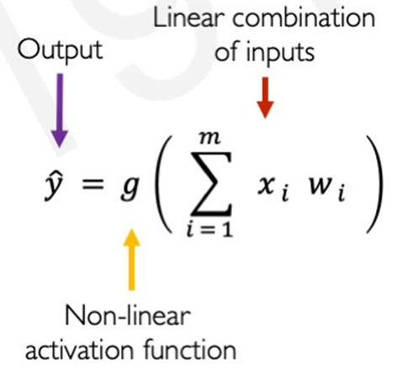
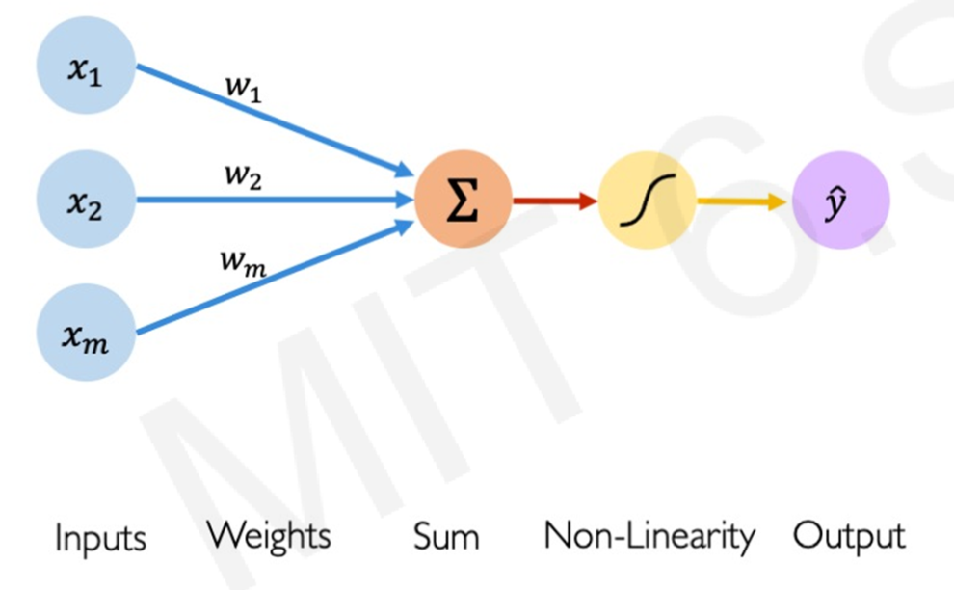
The Perceptron: Forward Propagation

Slide 5
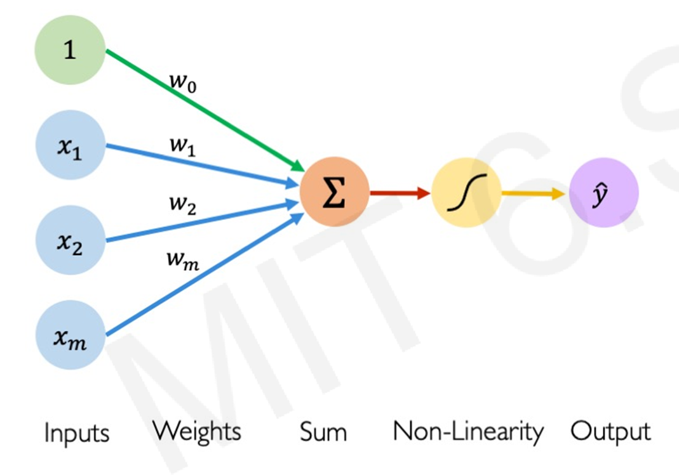
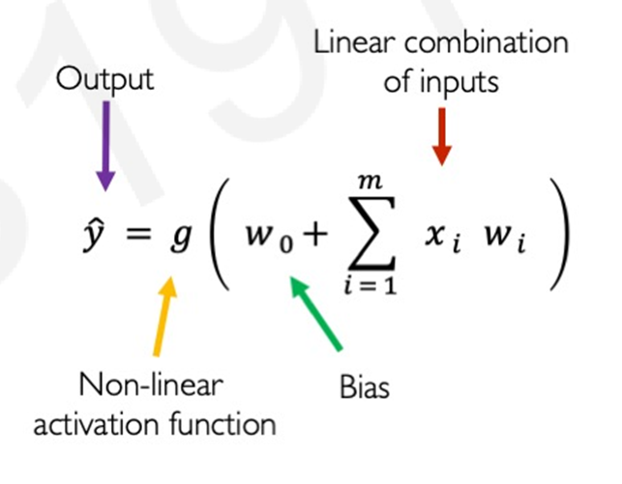
The Perceptron: Forward Propagation

Slide 6
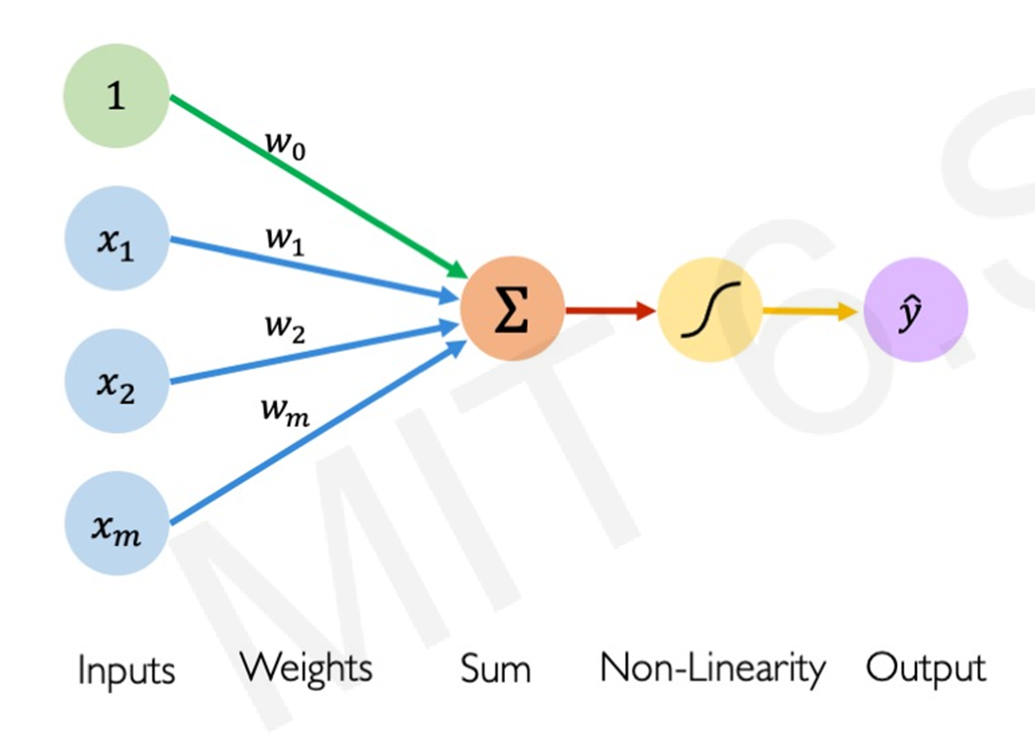
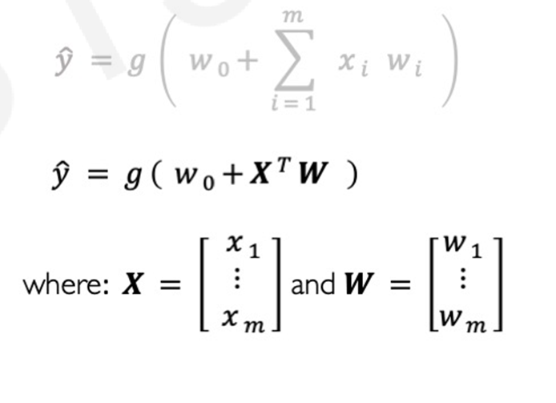
The Perceptron: Forward Propagation

Slide 7
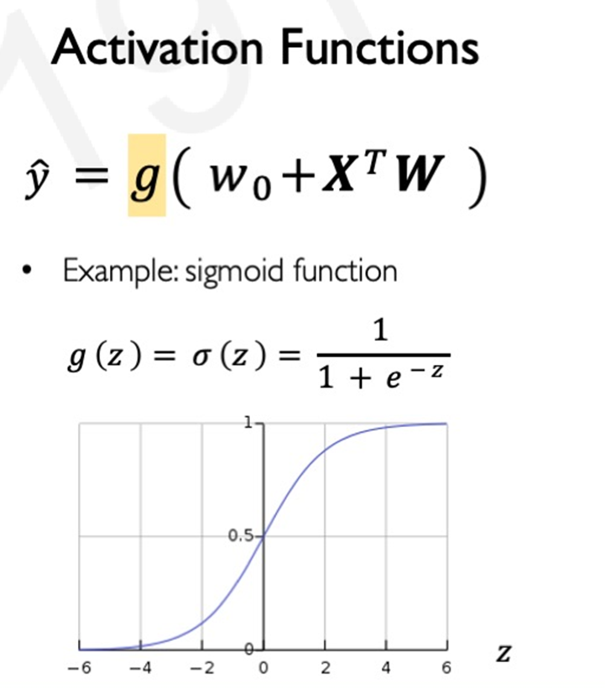
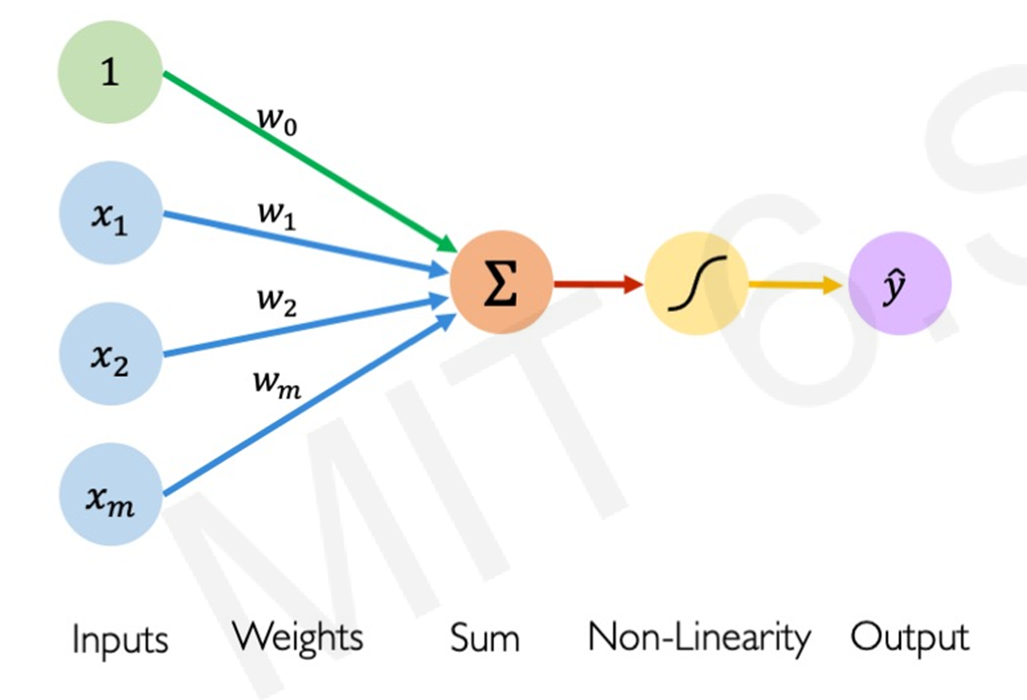
The Perceptron: Forward Propagation

Slide 8
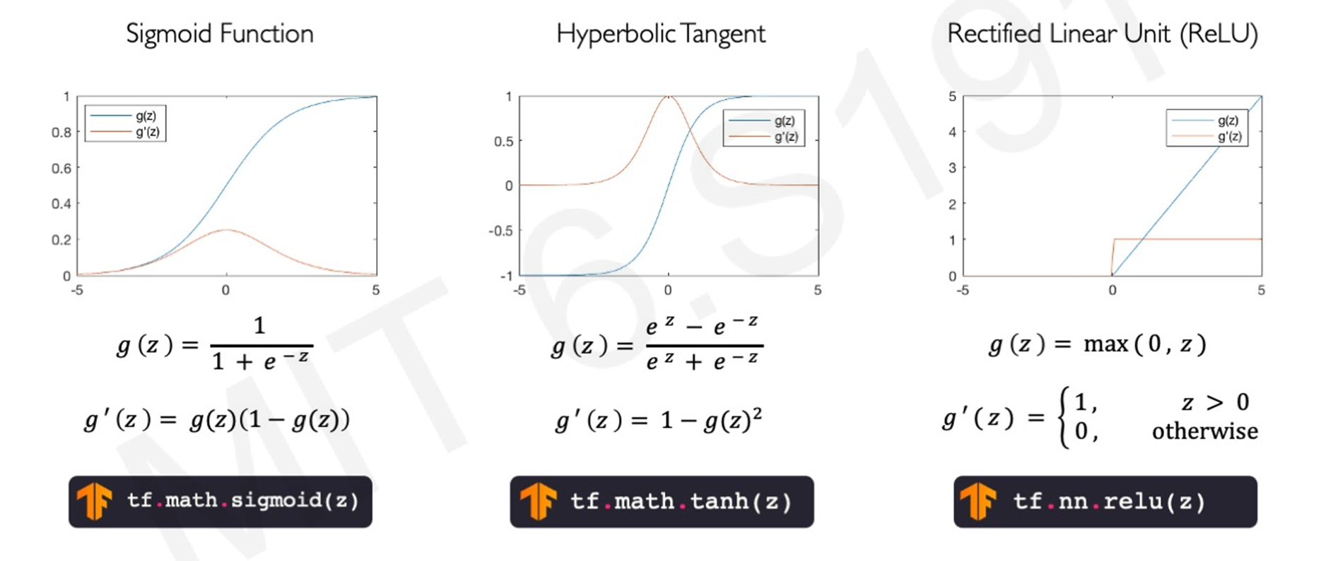
Common activation function

Slide 9
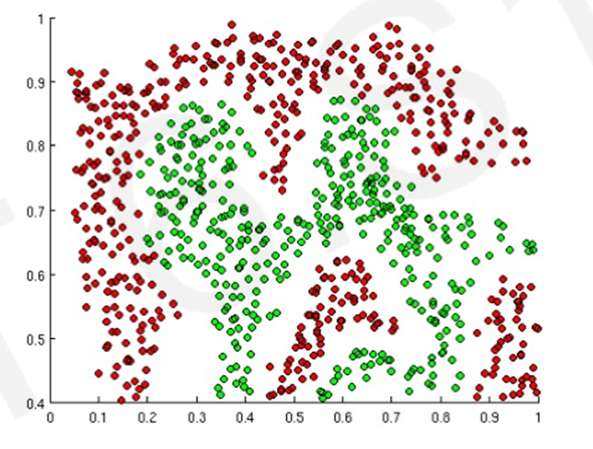
Importance of Activation Functions
What is the purpose of activation function?
The purpose of activation functions is to introduce non-linearity into the network
What if we wanted to build a neural network to distinguish green against red points?

Slide 10
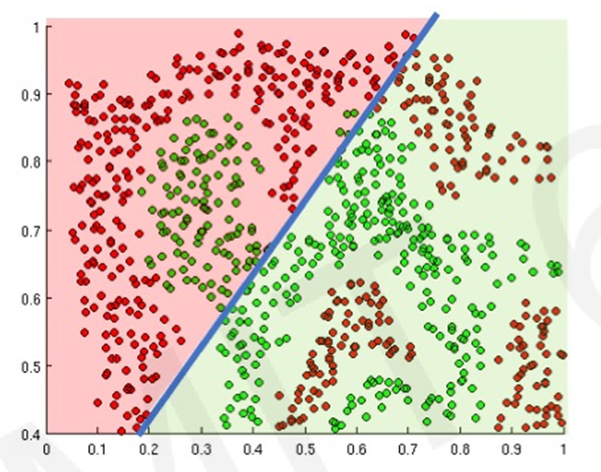
Importance of activation functions
The purpose of activation functions is to introduce non-linearity into the network
Linear activation functions produce linear decision boundary with minimal error

Slide 11
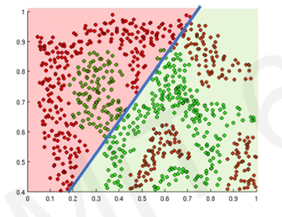
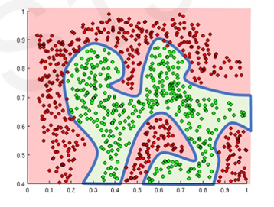
Importance of activation functions
The purpose of activation functions is to introduce non-linearity into the network
Non-linearity allow us to approximate arbitrarily complex functions

Slide 12
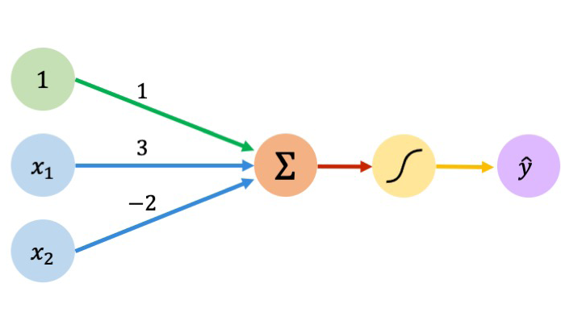
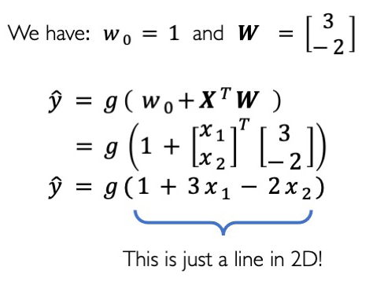
The perceptron: Example

Slide 13
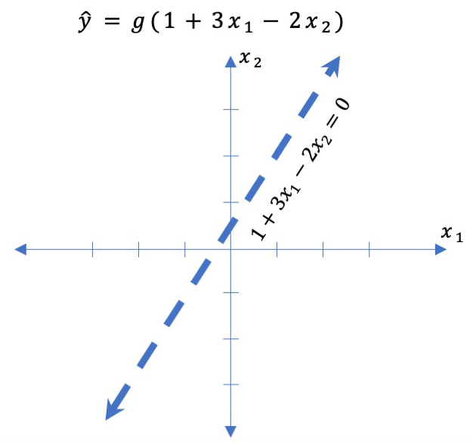
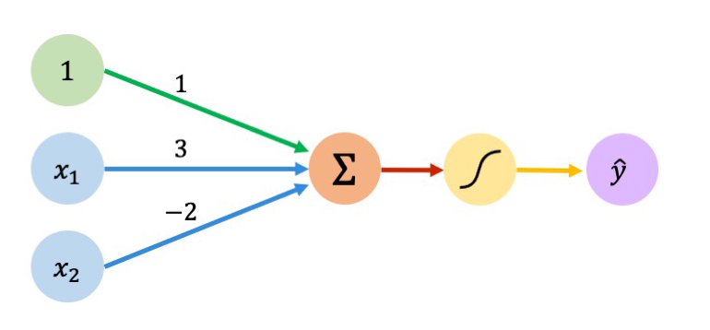
The perceptron: Example

Slide 14
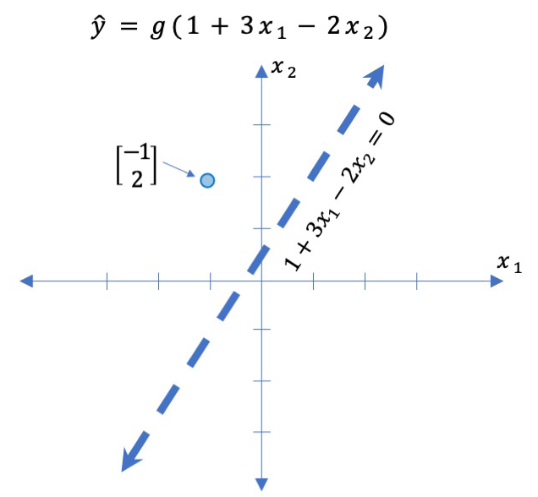
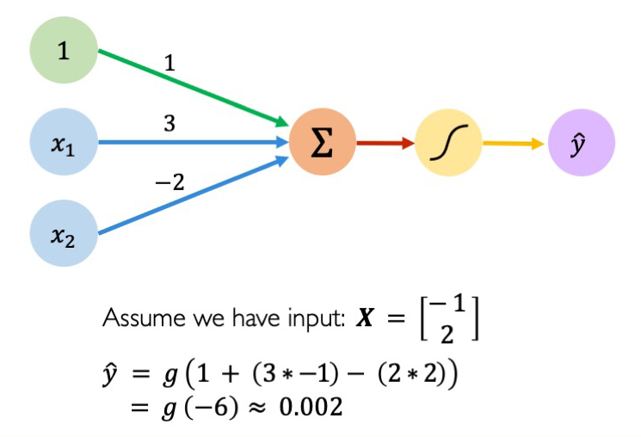
The perceptron: Example

Slide 15
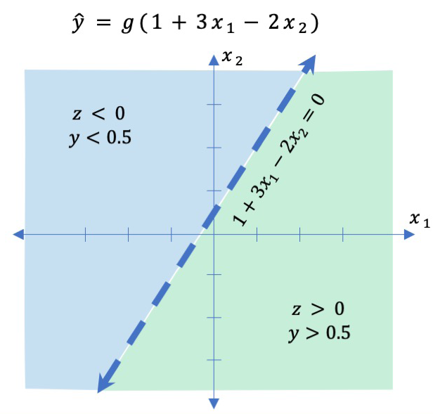
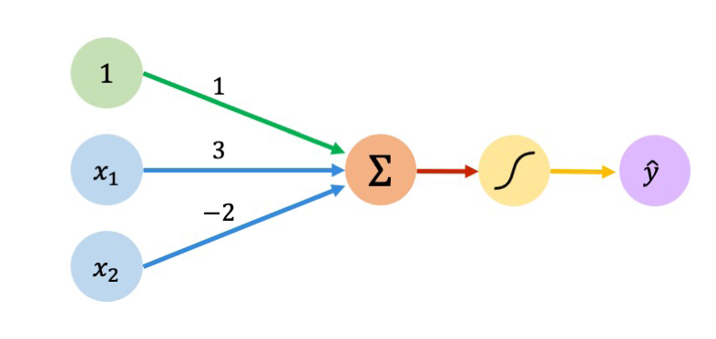
The perceptron: Example

Slide 16
Neural Networks
Building Neural Networks with Perceptorns

Slide 17
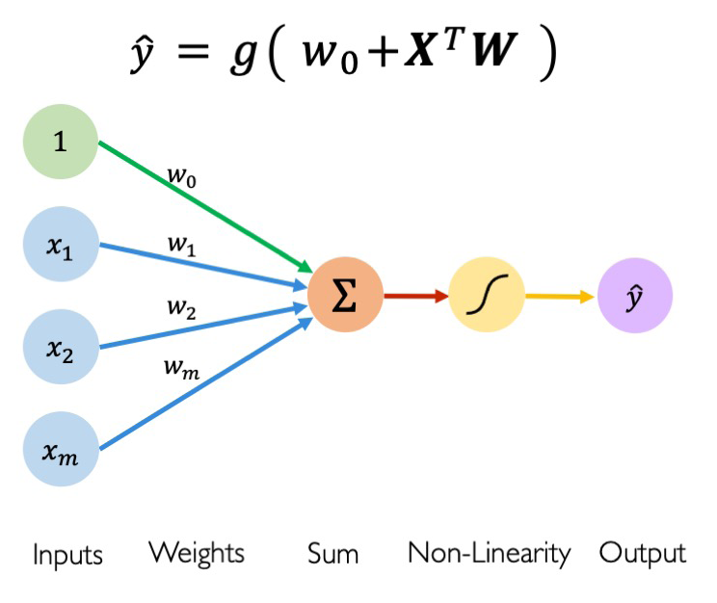
The perceptron : Simplified

Slide 18
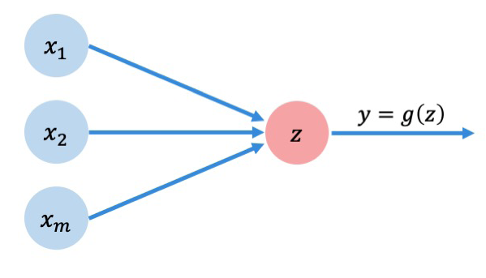
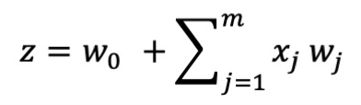
The perceptron : Simplified
This is also called as Single Layer Single Output

Slide 19
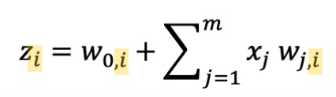
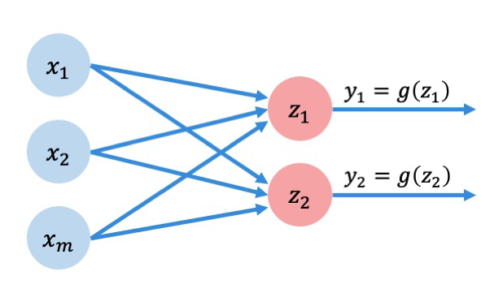
Neural Network: Single Layer Multiple Output or Multi output Perceptron
Because all inputs are densely connected to all outputs
These layers are called Dense layers or sometimes fully connected layers

Slide 20
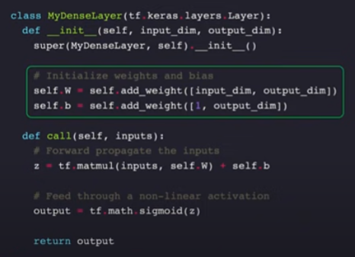
Dense layer from scratch in TensorFlow

Slide 21
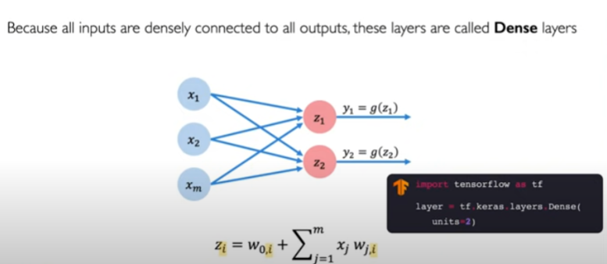
Neural Network: Single Layer Multiple Output or Multi output Perceptron

Slide 22
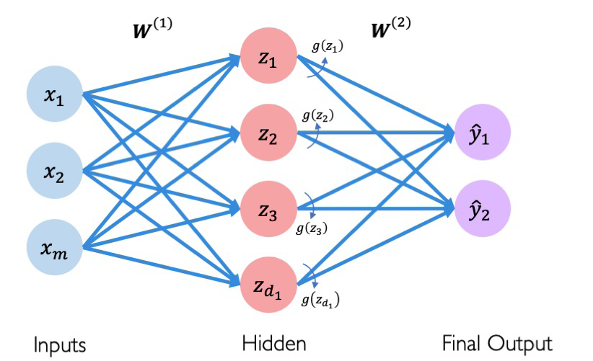
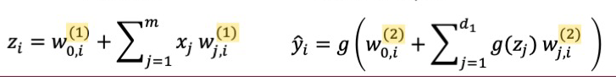
Neural Network: Multiple Layer Multiple Output
Multiple Layer Neural Networks

Slide 23
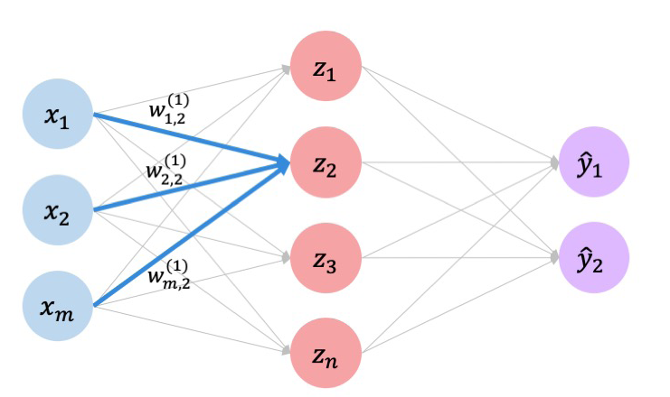
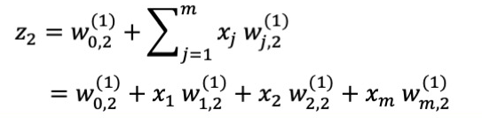
Multiple Layer Neural Network

Slide 24
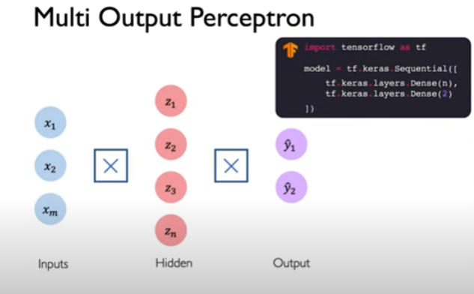
Multi Output Perceptron (Multiple Layer Perceptorn)

Slide 25
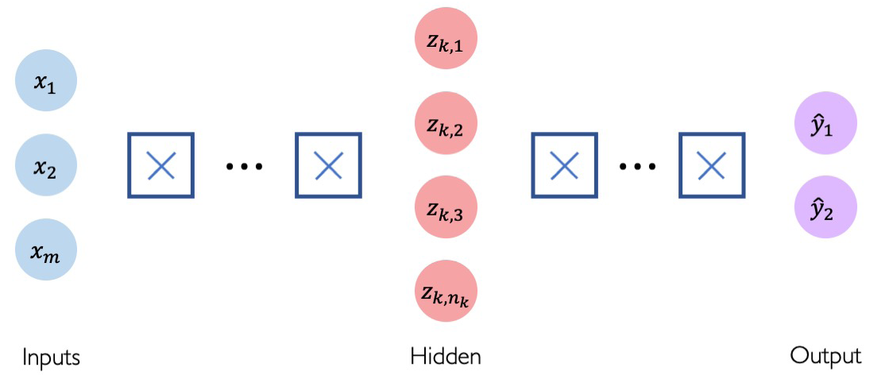
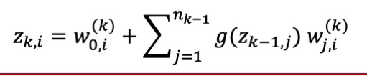
Deep Neural Networks

Slide 26
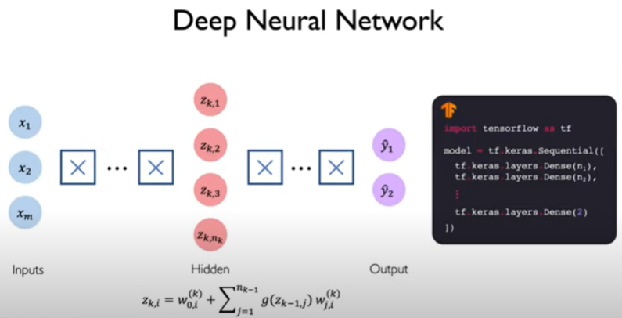
Deep Neural Networks

Slide 27
Summary
The perceptron
Activation Functions
Neural Networks
Types of Neural Networks
Deep Neural Networks

Slide 28
Neural Networks
Applying Neural Networks

Slide 29
Example Problem
How do expertise in the field of deep learning?
Lets start with a simple two feature model
X₁= Number of lectures you attend
X₂= Hours spent on each topics and the final project

Slide 30
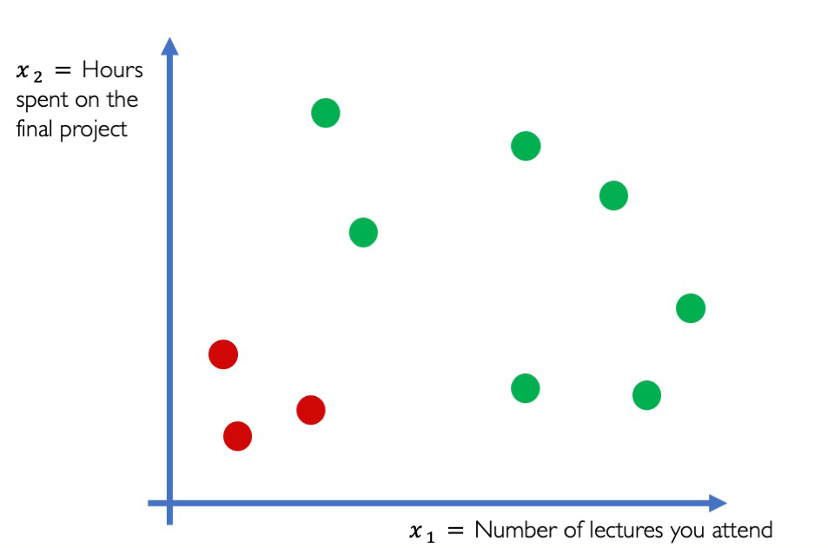
Example Problem
How do expertise in the field of deep learning?

Slide 31
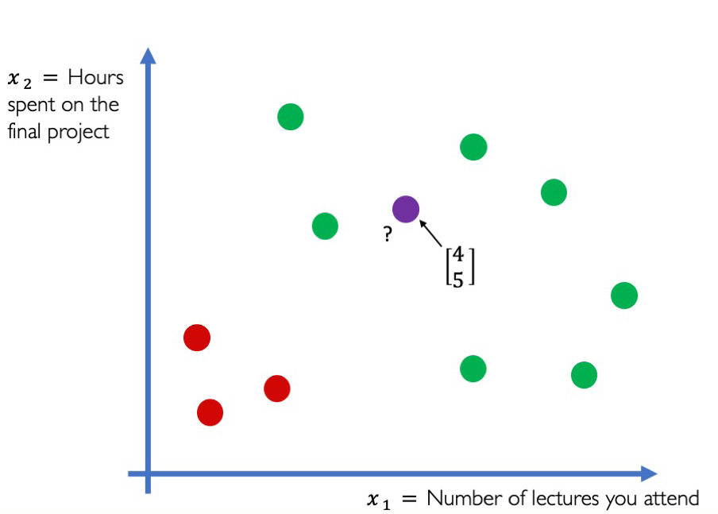
Example Problem
How do expertise in the field of deep learning?

Slide 32
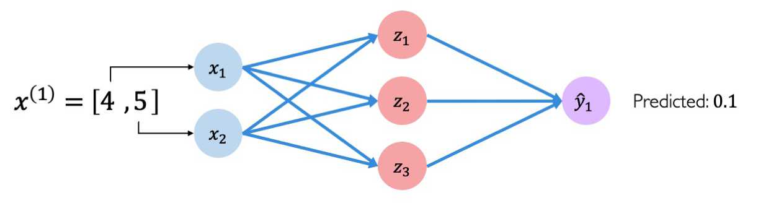
Example Problem
How do expertise in the field of deep learning?

Slide 33
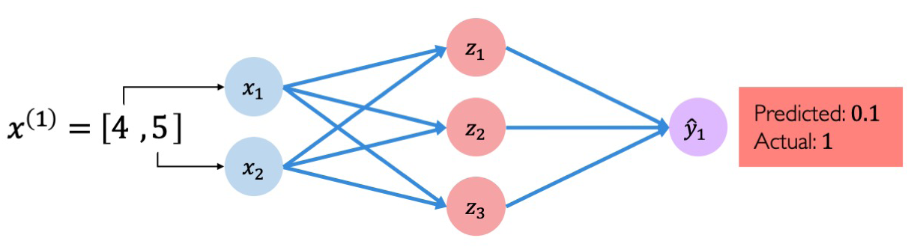
Example Problem
How do expertise in the field of deep learning?

Slide 34
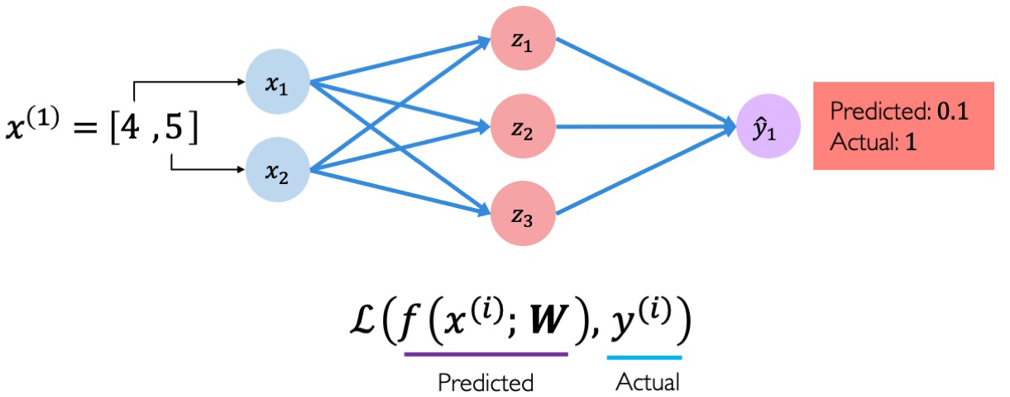
Quantifying loss
The loss of our network measures the cost incurred from incorrect predictions (misclassified samples)

Slide 35
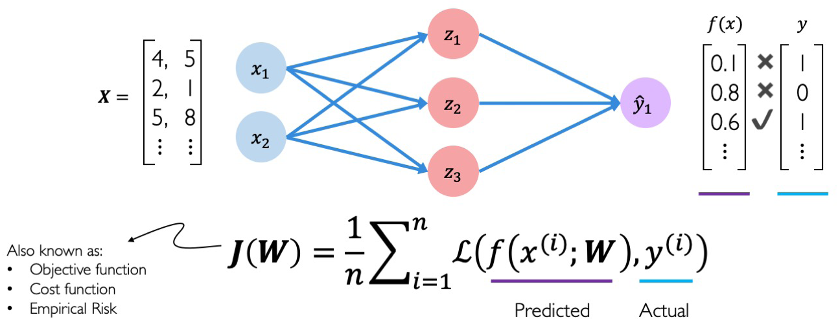
Empirical Loss
The empirical loss (mean loss) measures the total loss over our entire dataset. Let say there are n samples

Slide 36
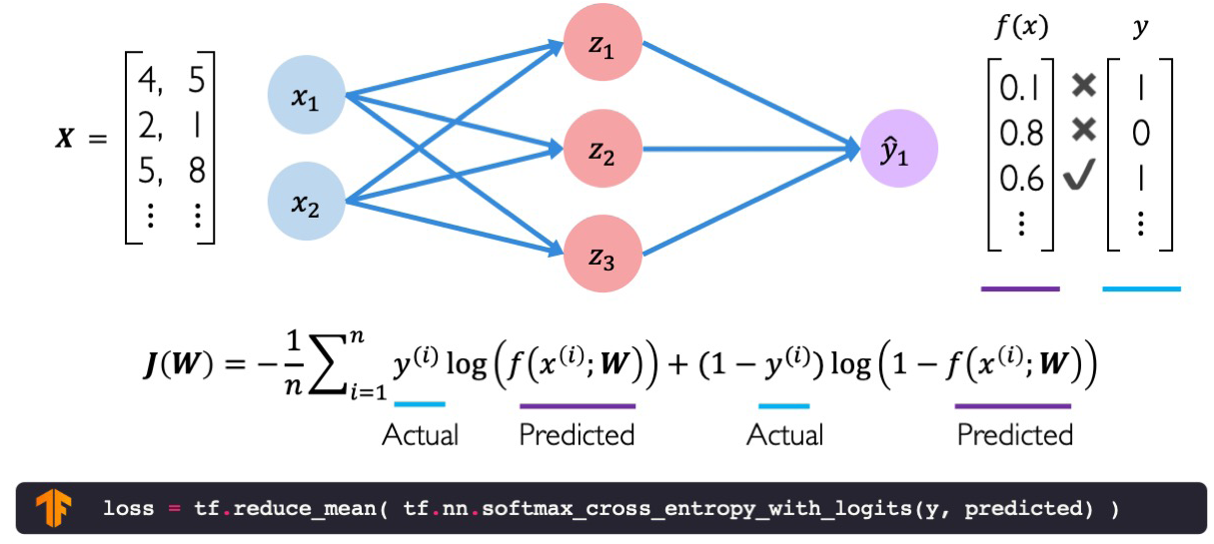
i) Binary cross entropy loss
Cross entropy loss can be used with models that output a probability between 0 and 1

Slide 37
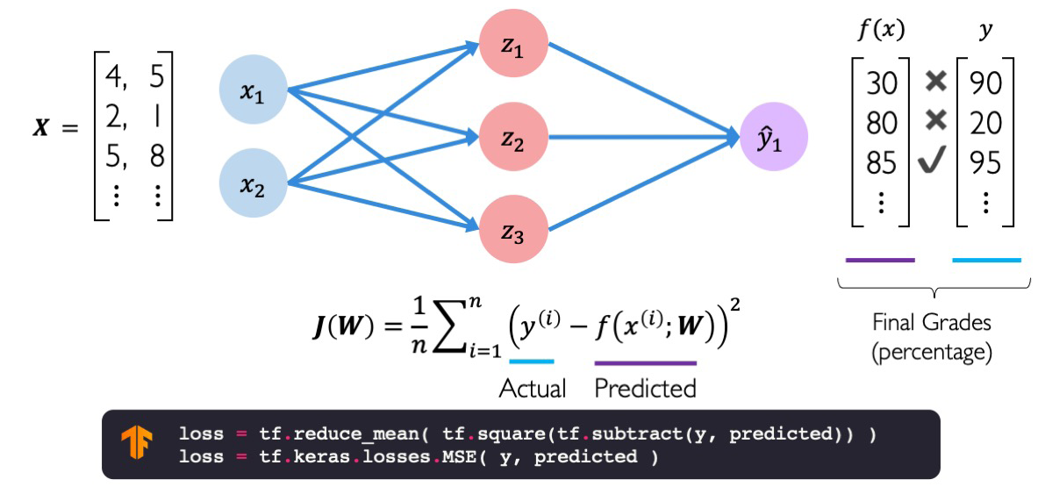
ii) Mean Squared Error Loss
Mean squared error loss can be used with regression models that output continuous real numbers

Slide 38
Neural Networks
Training Neural Networks

Slide 39
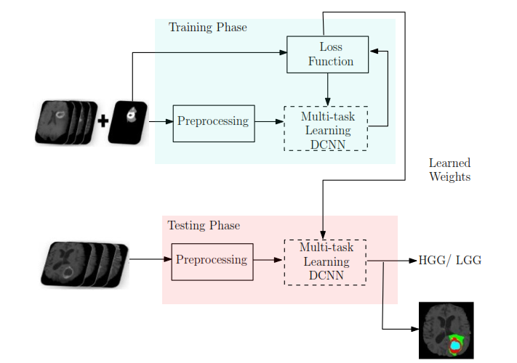
Training Neural Network

Slide 40
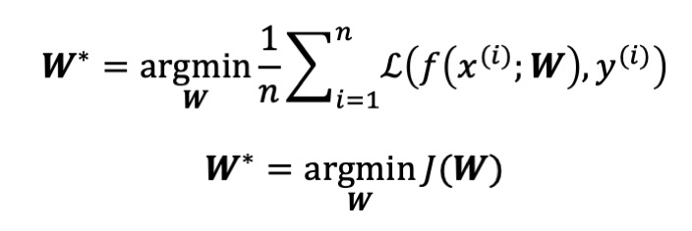
Loss optimization
The goal is to find the weight that achieve the lowest error rate

Slide 41
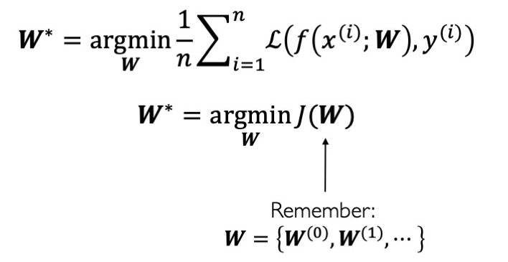
Loss optimization
The goal is to find the weight that achieve the lowest error rate

Slide 42
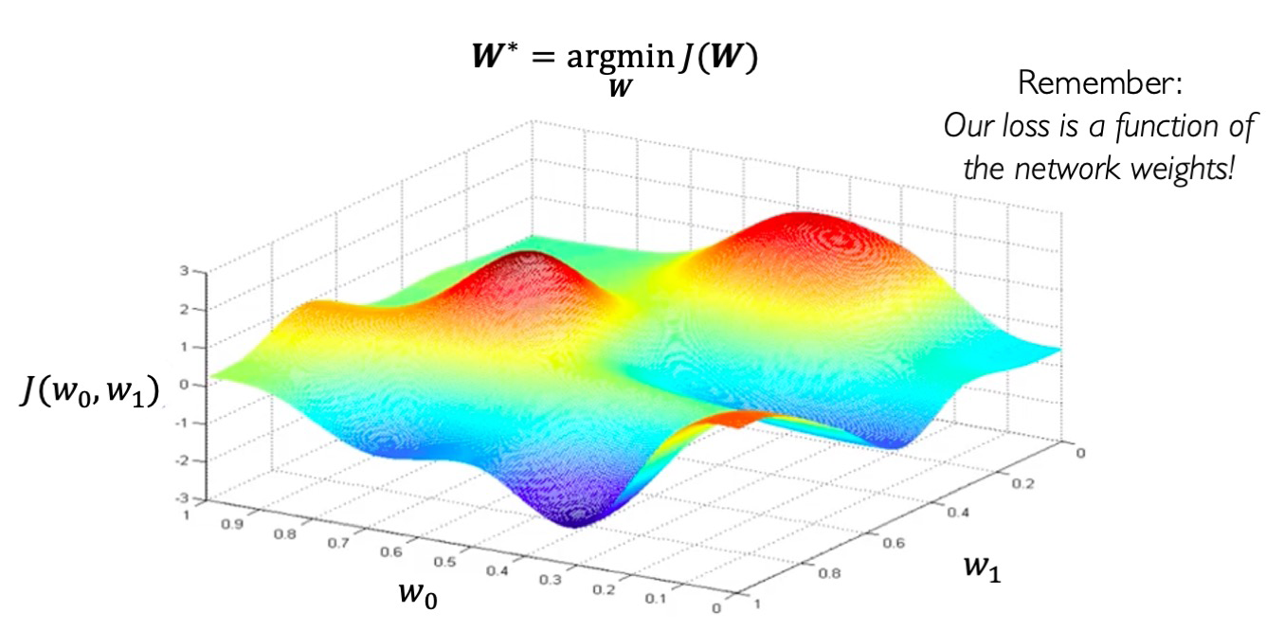
Loss optimization

Slide 43
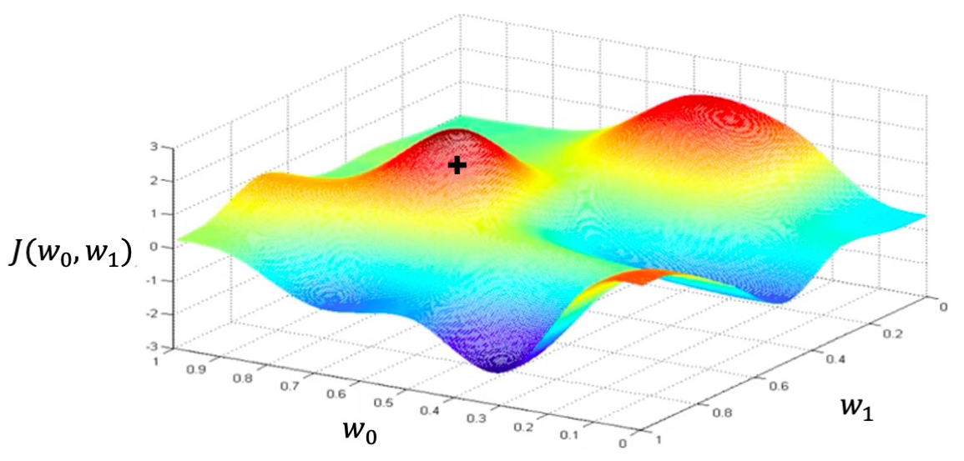
Loss optimization
Randomly pick an initial weight (wo,w1)

Slide 44
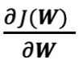

Loss optimization
Compute gradient

Slide 45

Loss Optimization
Take small step in opposite direction of gradient

Slide 46

Gradient Descent
Repeat until convergence

Slide 47

Gradient Descent

Slide 48

Gradient Descent

Slide 49

Loss optimization for linear regression

Slide 50

Gradient Descent Algorithm

Slide 51

Gradient Descent

Slide 52

Computing Gradients (Step 3): Back propagation
How does a small change in one weight (w₂) affect the final loss J(w)?

Slide 53

Computing Gradients: Back propagation
How does a small change in one weight (w₂) affect the final loss J(w)?
Lets use chain rule

Slide 54

Computing Gradients: Back propagation
How does a small change in one weight (w₂) affect the final loss J(w)?
Lets use chain rule

Slide 55

Computing Gradients: Back propagation

Slide 56

Computing Gradients: Back propagation

Slide 57
Computing Gradients: Back propagation
Repeat this for every weight in the network using gradients from last layers

Slide 58
Neural Networks in Practice
Loss Optimization
Batch Optimization
Overfitting

Slide 59

Training Neural Networks is Difficult
Visualizing the loss landscape of neural net, Dec 2017
Loss functions can be difficult to optimize

Slide 60

Loss Optimization
The loss is extremely non convex

Slide 61

Loss Optimization
Loss function is optimized through gradient descent

Slide 62

Loss optimization
How can we set the learning rate?

Slide 63

Loss optimization
Small learning rate converges slowly and gets stuck in false local minima
Large learning rate overshoot, become unstable and diverge
Stable learning rates converge smoothly and avoid local minima

Slide 64
Loss optimization
How to deal with this?
Idea 1: Try lots of different learning rates and see what works “right”
Idea 2: Do something smarter ! Design an adaptive learning rate that “adapts” to the landscape

Slide 65
Adaptive Learning Rates
Learning rates are no longer fixed
Can be larger or smaller depending on
How large gradient is
How fast learning is happening
Size of particular weight
Etc.

Slide 66

Gradient Descent Algorithms
Algorithm
SGD
Adam
Adadelta
Adagrad
RMSProp

Slide 67
Neural Networks in Practice
Loss Optimization
Batch Optimization
Overfitting

Slide 68

Gradient Descent

Slide 69

Gradient Descent
It can be computationally intensive to compute

Slide 70

Stochastic Gradient Descent
Easy to compute but very noisy

Slide 71

Fast to compute and a much better estimate of the true gradient

Slide 72
Mini-batches while training
More accurate estimation of gradient
Smoother convergence
Allows for larger leaning rates
Mini-batches lead to fast training

Slide 73

Error minimization with iterations

Slide 74
Neural Networks in Practice
Loss Optimization
Batch Optimization
Over-fitting

Slide 75

The problem of Over-fitting
It is also known as problem of generalization

Slide 76

The problem of Over-fitting

Slide 77

The problem of Over-fitting

Slide 78
Regularization
What is it?
Technique that constrains our optimization problem to discourage (not to have) complex models
Why do we need it?
Improve generalization of our model on unseen data

Slide 79

Regularization 1: Dropout
During training, randomly set some activation to 0

Slide 80


Regularization 1: Dropout
During training, randomly set some activation to 0
Typically ‘drop’ 50% of activations in layer
Forces network to not rely on any one node

Slide 81

Regularization 1: Dropout
During training, randomly set some activation to 0
Typically ‘drop’ 50% of activations in layer
Forces network to not rely on any one node

Slide 82

Regularization 1: Dropout

Slide 83

Regularization 2 : Early Stopping
Stop training before we have a chance to overfit

Slide 84

Regularization 2 : Early Stopping
Stop training before we have a chance to overfit

Slide 85

Regularization 2 : Early Stopping
Stop training before we have a chance to overfit

Slide 86

Regularization 2 : Early Stopping
Stop training before we have a chance to overfit

Slide 87

Regularization 2 : Early Stopping
Stop training before we have a chance to overfit

Slide 88

Regularization 2 : Early Stopping
Stop training before we have a chance to overfit

Slide 89

Regularization 2 : Early Stopping

Slide 90

Summary

Slide 91
Thank you

Slide 92

Extra Slides

Slide 93
Sources:
Loss Functions
https://deeplearningdemystified.com/article/fdl-3
https://gombru.github.io/2018/05/23/cross_entropy_loss/

